Slide 1
MVC 5
(Model-View-Controller)
Deployment
Notes:
Prije početka pitati za iskustva koja polaznici imaju oko MVC 4.

Slide 2
Web Deployment Packages
IIS Settings
  Application Pool
  Authentication method
  Error Handling
Deploy Database Scripts
Production Settings
  Release / Debugging
  Connection Strings
Capable of Custom Extensions
  Security Certificates
  Windows Registry Settings
  Assemblies in Global Assembly Cache (GAC)
Notes:
The information in this topic solely relates to Web Application Projects (WAP), and is all about what goes into a package and how to include it.
Question: In which scenarios have you used web deployment packages? What were the advantages? What were the disadvantages?
Answer: Will vary.

Slide 3
One-Click Publish
Deploy Remotely Directly from Visual Studio Toolbar
Create Publish Profiles to Specify Settings
  Different Servers Same Settings
  Same Server Different Settings
  Different Servers Different Settings
Compatible with Third Party Hosting
  Requires Additional Information from Hosting Company
Notes:
One-Click Publishing is the simple and connected way of deploying a Web application, unlike Web Deploy packages, which can be sent to the administrator of the destination server for deployment at an appropriate time.
Question: In which scenarios have you used One-Click publishing? What were the advantages? What were the disadvantages?
Answer: Will vary.

Slide 4
Enterprise Scenarios
Must have remote access to target server
Developer
Computer
Test
Server
Publish
Developer
Computer
Test
Server
Package
Developer
Computer
Source Control
Test
Server
Package
Production
Server
Test
Server
Staging
Server
Production
Server
Package
Package
Production
Server
Notes:
Ensure the students how about different scenarios for which to deploy Web applications.
Question: How many intermediate environments have you seen in an enterprise scenario? Did you ever encounter a scenario where no intermediate environments were used?
Answer: Will vary.

Slide 5
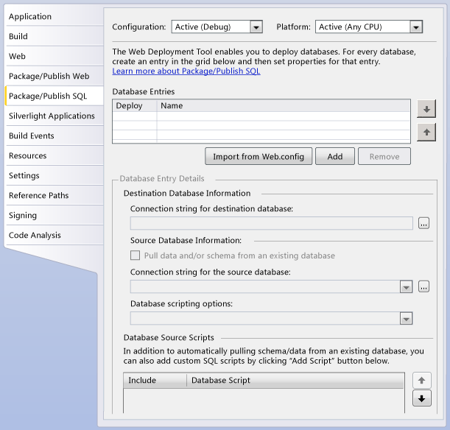
Deploying a SQL Server Database
Notes:
Make sure the students know how simple it is to use the Package/Publish SQL page of the Project Designer to get all database information packages.
Question: How do you currently propagate data structures and data? What are the advantages? What are the disadvantages?
Answer: Will vary

Slide 6
Overview of Website Deployments
The Copy Web Site Tool
The Publish Web Site Utility
Web.config File Deployment

Slide 7
The Copy Web Site Tool
Similar to FTP Utility
Support Synchronization
Especially useful when you cannot open files from the remote site to edit them
Provides Status of Files
  Unchanged
  Changed
  New
  Deleted
Notes:
Question: Where have you leveraged the Copy Web Site tool?
Answer: Will vary
Question: What are some advantages to not having to recompile an application?
Answer: Faster, less chance of a component not functioning properly.

Slide 8
The Publish Web Site Utility
Precompiles pages, the source code in the App_Code folder, and other source files into executable output.
  Strips the source code out of files
  Leaves Stub Files and Compiled Assemblies
Writes the executable output to a target folder.
Notes:
Question: Where have you leveraged the Publish Web Site utility?
Answer: Will vary.
Question: What are some advantages to having to recompile the application?
Answer: Ensures that all code is up to date and any compile errors are found.

Slide 9
Web.config File Deployment
Edit the Web.config file on the target server each time the project is deployed.
Maintain separate versions of the Web.config file for each environment (perhaps in separate folders or with distinctive names), and copy only the version that is appropriate to the target server.
Create XSLT files to transform the Web.config and manually apply the transforms manually when deploying.
<?xml version="1.0"?>
<configuration xmlns:xdt="http://schemas.microsoft.com/XML-Document-Transform">
<connectionStrings>
<add name="ApplicationServices"
connectionString="[ProductionDatabase]"
xdt:Transform="Replace" xdt:Locator="Match(name)"/>
</connectionStrings>
</configuration>
Typical transform file
Notes:
Question: Where have you leveraged the Publish Web Site utility?
Answer: Will vary.

Slide 10
Metode kompajliranja web aplikacije
Automatsko kompajliranje
  Aplikacija se kompajlira prvi put kada korisnik zatraži resurs sa web aplikacije ili site-a.
    Kreira se jedan sklop (assembly) za svaki direktorij, uključujući korijenski direktorij.
    Ako postoje datoteke koje sadrže kod više od jednog programskog jezika, imati ćemo jedan sklop (assembly) za svaki direktorij i za svaki jezik dodatno.
  Kako bi izbjegli dugo čekanje na odziv kod prvog pristupa, aplikacija može biti prekompajlirana.
Dinamičko kompajliranje
  Nakon prvog kompajliranja, datoteke su spremljene (cached) u memoriju.
  Bilo koja promjena kodiranih datoteka će biti okidač za rekompajlirannje.
  Kompajlirane datoteke su smještene na lokaciji: %SystemRoot%\Microsoft.NET\Framework\versionNumber\Temporary ASP.NET Files
Notes:
Describe the following:
Automatic compilation http://msdn.microsoft.com/en-us/library/ms178466.aspx
Dynamic compilation http://msdn.microsoft.com/en-us/library/ms366723.aspx

